Slide 1
UNIT 4
Cloud Computing Technologies and Applications

Slide 2
Table of Content
Cloud Computing Technologies and Applications :
Content Delivery Network (CDN) Services,
Multi-CDN, Features of Meta CDN,
Mobile Cloud Computing (MCC),
InterCloud Issues

Slide 3
Content Delivery Network (CDN) Services in CLoud
A content delivery network (CDN) is a geographically dispersed network of servers and data centers.
The primary goal of a CDN is to improve web performance by reducing the time needed to send content and rich media to users.
CDN architecture is also designed to reduce network latency caused by hauling traffic over long distances and across several networks.
CDN servers are often referred to as "edge servers" since all CDN servers are located on the "edge network" — closer to end-users than a host server from which an application or a website originates.

Slide 4
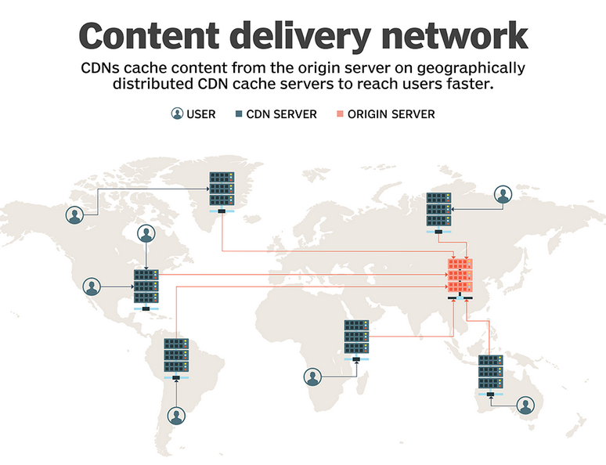

Slide 5
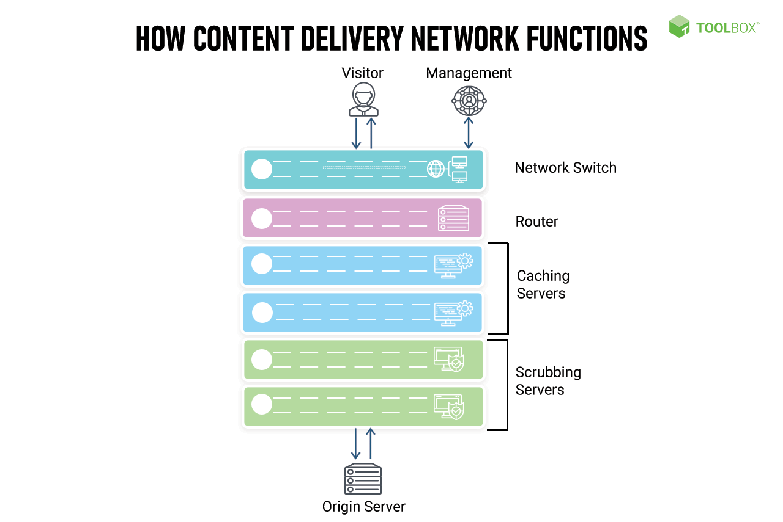

Slide 6
Why switch to CDN?
Today’s Internet architecture is based on centralized servers delivering files to all points on the Internet. Bottlenecks can occur with this approach
Network link congestion—This is the data transmission delay associated with the capacity (bandwidth) of the telecommunication network. More users, richer media, and more complex applications consumes more bandwidth, resulting in increased congestion.
Network equipment congestion—As network traffic increases, routers and switches must process more information packets. Packets collect in queues for processing. Overloaded network equipment discards queued data packets. They are then retransmitted, adding to traffic.
Web server congestion—The larger the traffic flow on a Web site, the more requests for data must be served and processed by the server. Until the data is served, the requests sit in a queue, resulting in delay and a slow Web experience.
Distance delay in the network—This is due to the time associated with data traveling over long distances.

Slide 7
Elements of content delivery networks
Content Distribution and Management—Configures CDN devices, manages content, assigns network policies, and monitors network performance
Content Routing—Reliably redirects user requests to the best location in the CDN
Content Switching—Intelligently switches and balances traffic load across multiple servers
Content Edge-Delivery—Delivers content from the network edge to the desktop
Intelligent Network Services—Provides network services such as security, QoS and Multicast in the network infrastructure

Slide 8
Multi-CDN
A multi-CDN is the combination of multiple CDNs (content delivery networks) from different providers into a single network.
A multi-CDN strategy can help you reduce latency, improve performance and save costs
The need for a multi-CDN strategy arises when an organization’s traffic load increases beyond their current capacity limitations on one CDN provider or if they are looking to distribute their content geographically across providers strategically.
This is because of the many advantages to hosting content from different CDN providers – geographical redundancy, security, increased performance, and cost savings (multi-CDN can help reduce bandwidth costs by balancing out loads) and taking advantage of the pricing differences between different CDN vendors for different situations, time-slots, etc.

Slide 9
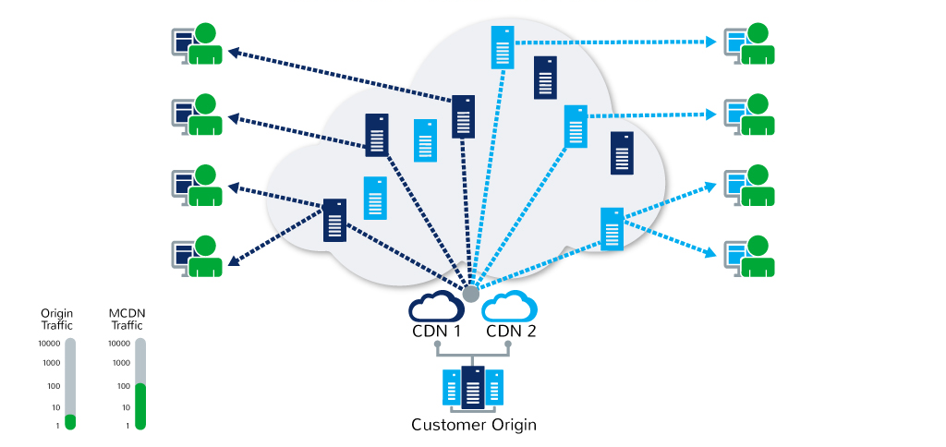
In a multi-CDN architecture, a website/streaming service’s content (images, video files, etc.) is cached across multiple CDN providers in different geographic regions.
With the help of intelligent load balancing algorithms and data collected at different points of the delivery pipeline, the incoming traffic from the video players (clients) is distributed across these multiple CDN providers, which provides greater redundancy and performance benefits.

Slide 10
Static Rules-based Switching vs. Dynamic Switching
Static Rules-based switching is a naïve form of CDN switching where a rules-engine is programmed with simple instructions like “if CDN-A fails, then divert traffic to CDN-B.” This does not accommodate a lot of intelligence and needs to be monitored tightly to ensure that situations not governed by the rules do not crash the system.
In Dynamic rules-based switching, the decision to switch CDNs is based on continuously collected from the players, CDNs themselves, and other business rules. As these factors change dynamically during the day, the decisions change adaptively.

Slide 11
Meta CDN
MetaCDN, a system that exploits ‘Storage Cloud’ resources, creating an integrated overlay network that provides a low cost, high performance CDN for content creators. MetaCDN removes the complexity of dealing with multiple storage providers, by intelligently matching and placing users’ content onto one or many storage providers based on their quality of service, coverage and budget preferences. MetaCDN makes it trivial for content creators and consumers to harness the performance and coverage of numerous ‘Storage Clouds’ by providing a single unified namespace that makes it easy to integrate into origin websites, and is transparent for end-users.

Slide 12
What is Origin Pull CDN?
Origin Pull CDN, by its name, means that the PoP server will be pulling the web page data and other elements from the origin server. The CDN itself will be the one deciding which content will be delivered to the web visitor when a web request is made.
How does it work? Well, you, the website owner or developer, will be the one responsible for leaving the content on the host origin server and you are the one who will rewrite URLs so that it points to the CDN.
When a web request is made, that is the moment that the PoP server will pull the web data and the other elements of your web page from the origin host server. This version will then be cached by the PoP server until it expires or is purged from the server.

Slide 13
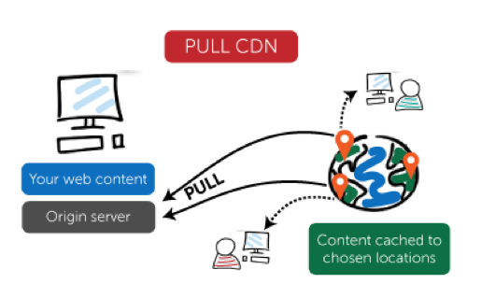

Slide 14
When to use Origin Pull CDN?
The main benefit of using origin pull CDN is that it is pretty easy to configure it’s the PoP server that does most of the lifting here. Also, because it only pulls data when there is a web request, you are saving on precious server space as well.
The disadvantage, however, is that it can also lead to some problems especially if you are negligent in updating your Time to Live settings or forgets to purge your PoP servers. What happens is that it can cause redundant traffic because web page data are re-queried even before they were changed.
Origin Pull CDN can also be slower at times, especially if the web page is requested for the first time because that is the moment that the PoP server will be pulling data from the Origin server before delivering the content to the web visitor.

Slide 15
What is Push CDN?
Push CDN, on the other hand, is the complete opposite of Origin Pull CDN and not only by name. In Pull CDN, the PoP server is responsible for the content being delivered. With Push CDN, it all falls on you, the website owner or developer.
Instead of waiting for the PoP server to pull the web page data when a request is made, you are already pushing the content you want on the PoP servers even before any request is made. These contents and its data and elements will be cached until it is deleted or purged.

Slide 16
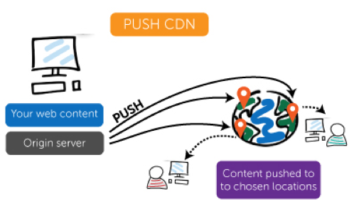

Slide 17
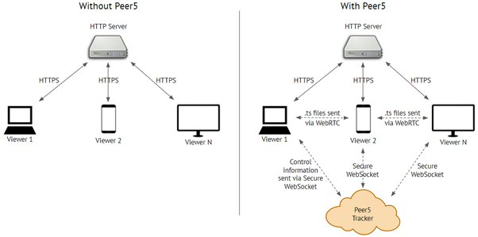
Peer to Peer CDN

Slide 18
Mobile Cloud Computing (MCC)
Mobile cloud computing (MCC) is the method of using cloud technology to deliver mobile apps.
Complex mobile apps today perform tasks such as authentication, location-aware functions, and providing targeted content and communication for end users.
Examples of MCC
Finance and Commerce: Using your phone or tablet to track your account balance, making a purchase on ecommerce platforms such as Amazon, Shopify, etc., is an example of mobile cloud computing

Slide 19
Types of Cloud-Based Resources in MCC are:
Distant Immobile Cloud Computing
Hybrid Cloud Computing
Distant Mobile Clouds
Proximate Immobile Computing Entities
Proximate Mobile Computing Entities

Slide 20
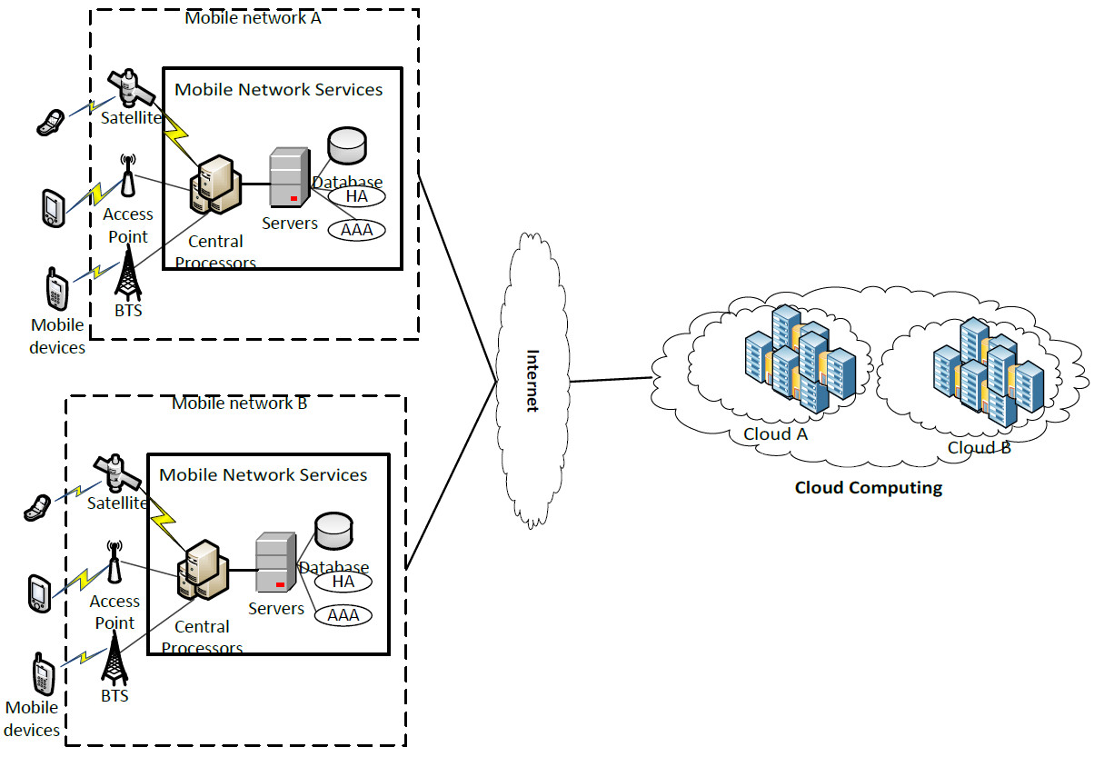

Slide 21
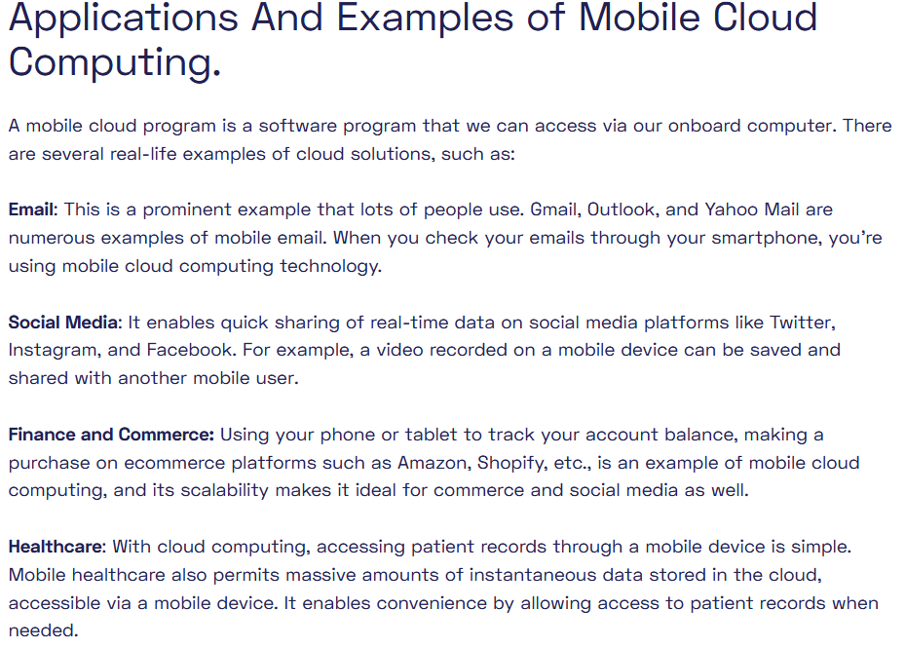

Slide 22
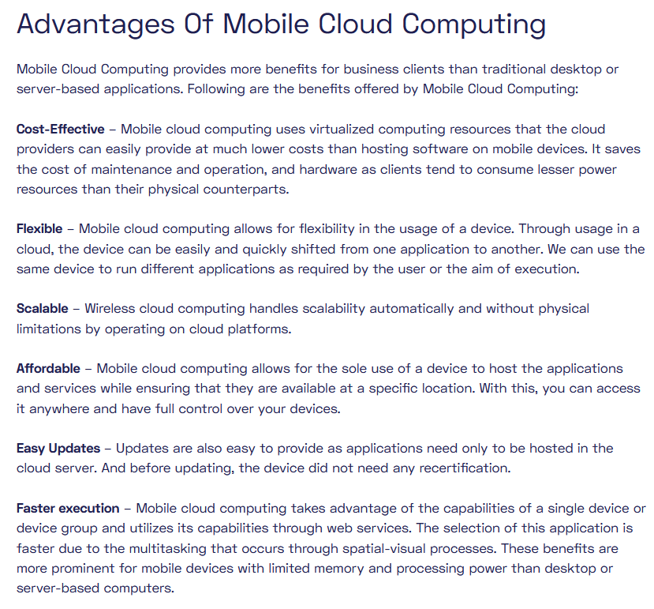

Slide 23
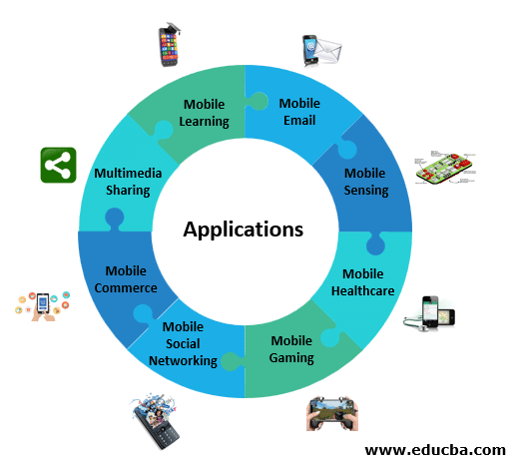

Slide 24
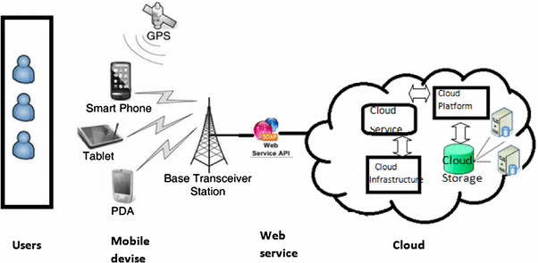

Slide 25
InterCloud Issues
Intercloud or ‘cloud of clouds’ is a common term used for cloud computing.
An intercloud architecture moves data between the infrastructure of multiple cloud service providers (CSPs).
Intercloud systems enable organizations to take complete control of their application on the cloud and use corporate data anywhere, anytime. It offers seamless connectivity and addresses common organizational issues, like security, performance, and flexibility.
The concept of Intercloud was first introduced to the world in 2008 when Cisco- the global leader in IT and networking, started it as a research project.
Later, it was taken over by IEEE (Institute of Electrical and Electronics Engineers) to improve the functionality of existing cloud networks.
Later in early 2009, it gained popularity and was regarded as the data center of the future.

Slide 26
Intercloud is a cloud deployment model that links multiple public cloud services together as one holistic and actively orchestrated architecture.
For example, Amazon, Google, Microsoft, Salesforce.com, and others have established data centers for hosting cloud application services such as social networking, gaming portals, and business applications.

Slide 27
Issues
Lack of interoperability and adopted standards together with intricate regulatory context,
inflexible pricing models and
not adequate SLAs are recognised as the main obstacles to Cloud adoption.

